Slide 1
Photo Album
Eng. Mohammed Mashharawi
Abu Anas
moh6390@Hotmail.com
@master212
www.linkedin.com/in/mohammed-mashharawi-86570b8b
https://github.com/Mashharawi
mohammed@mashharawi.com
by Mohammed AlMashharawi

Slide 2
About the trainer
Eng. AbuAnas Mashharawi
System & Cloud Engineer
High Tech. Expert
Computer Science – Baghdad University – Iraq
Microsoft Certified System Engineer
Cisco Admin
Trainer
Over than 15 years of networking and helpdesk assistance
Notes:
A+ Guide to IT Technical Support, 9th Edition
Chapter 1
First Look at Computer Parts and Tools

Slide 3
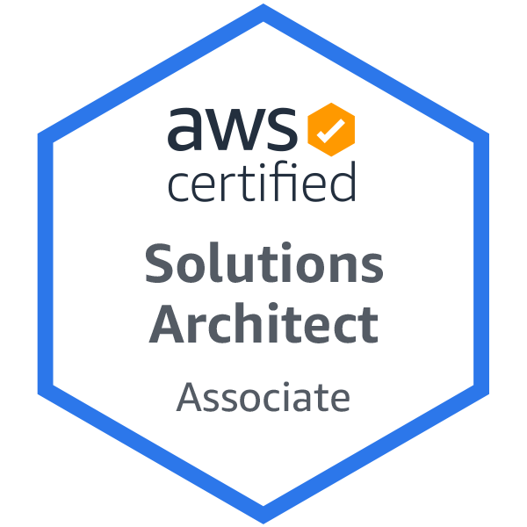
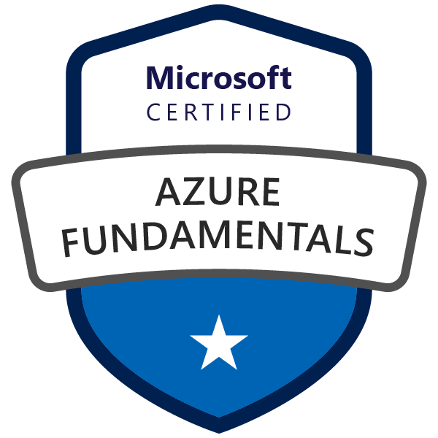
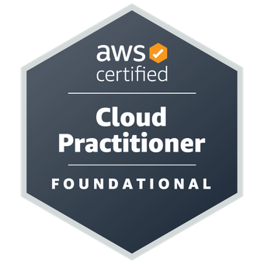
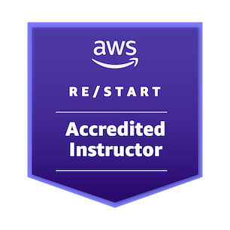

Slide 4


Slide 5

الدورة تهدف الي تعليم الطلاب وتعريفهم بمهارات بعض خدمات امازون علي الحوسبة السحابية –
This course is aiming to educate youth and students about some AWS Cloud Computing Basics

Slide 6

Why Computing?
The beginning of the story.
Notes:
Calculates – app – comm – entertainments – Co.’s -- https://www.javatpoint.com/computer-fundamentals-tutorial -- https://www.learncomputerscienceonline.com/introduction-to-computer-system/

Slide 7
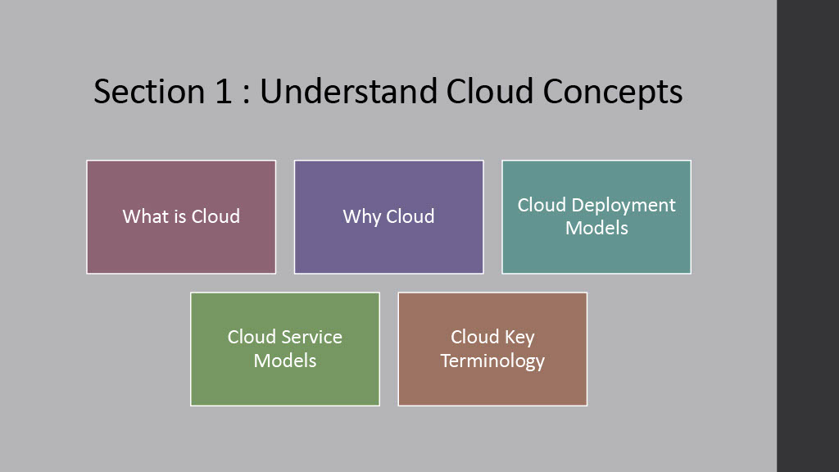

Slide 8
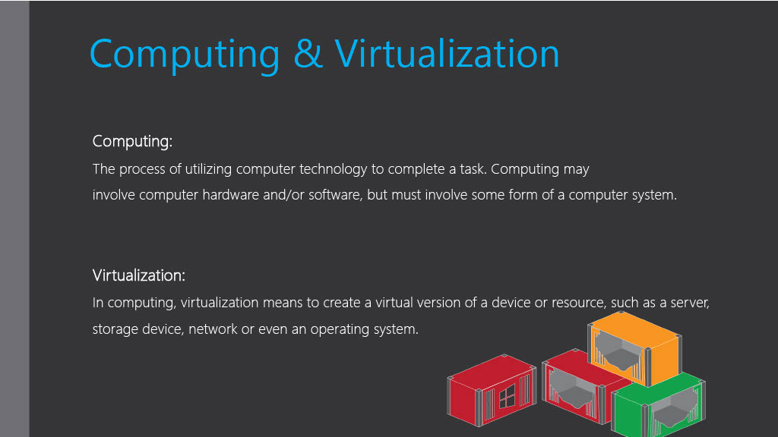

Slide 9
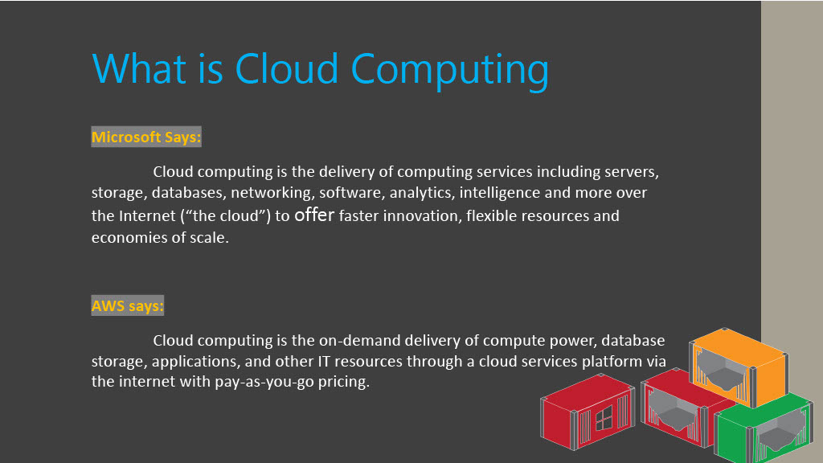

Slide 10
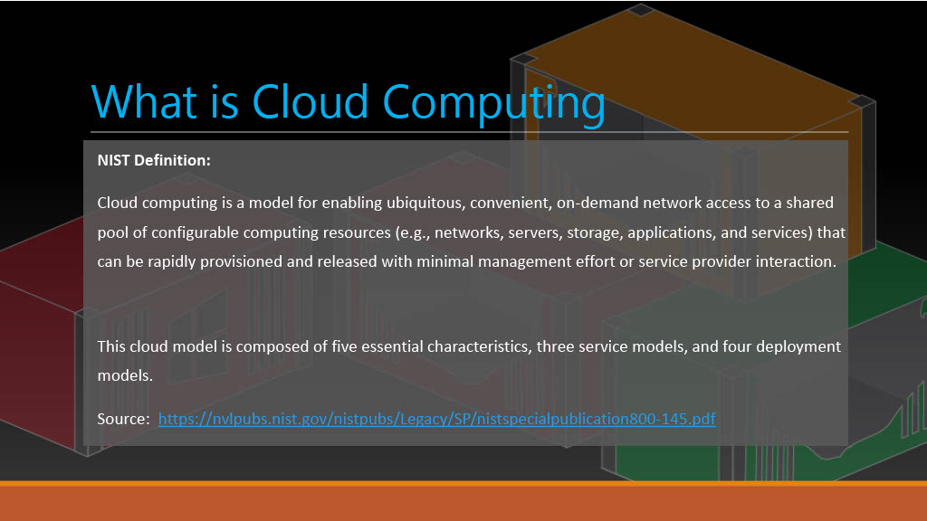
Notes:
https://nvlpubs.nist.gov/nistpubs/legacy/sp/nistspecialpublication800-145.pdf --- ubiquitous --- في كل مكان

Slide 11
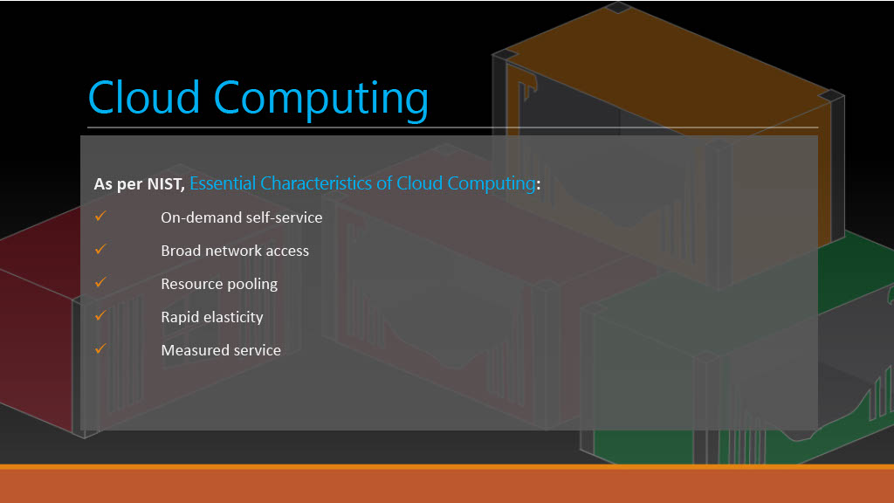
Notes:
pooling of resources --- تجميع موارد

Slide 12
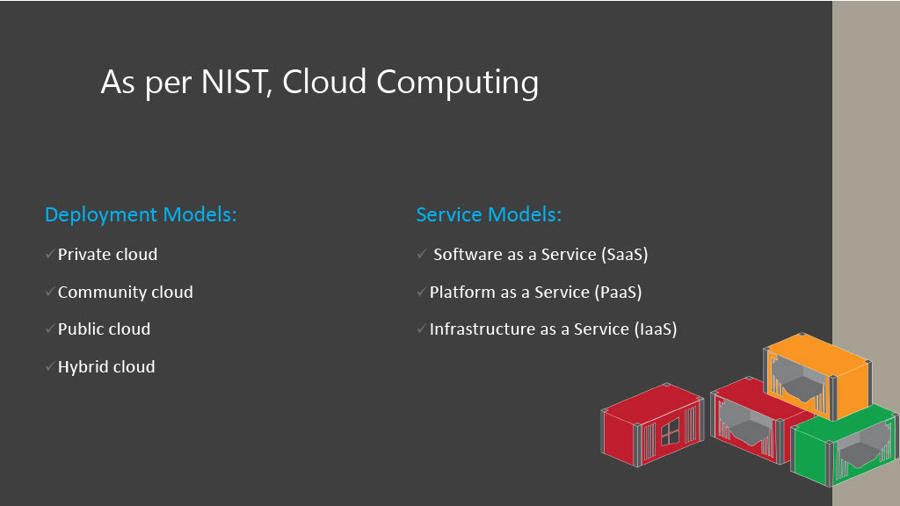

Slide 13
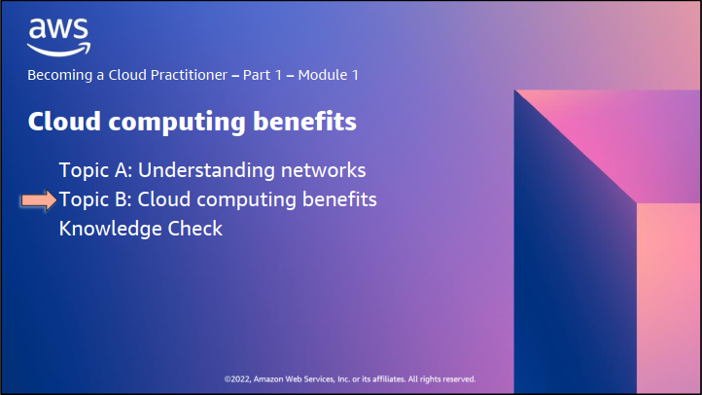

Slide 14
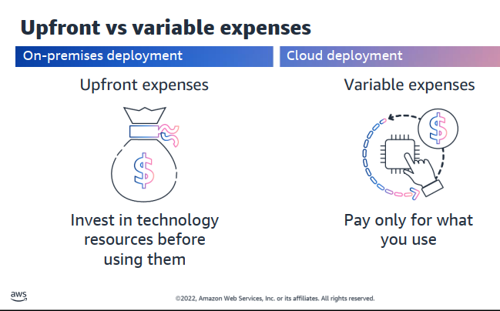

Slide 15
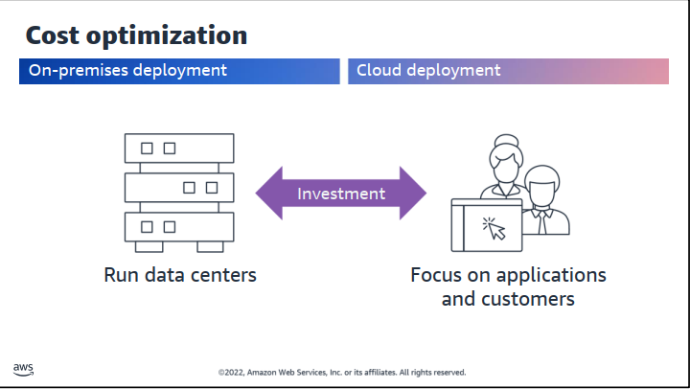

Slide 16
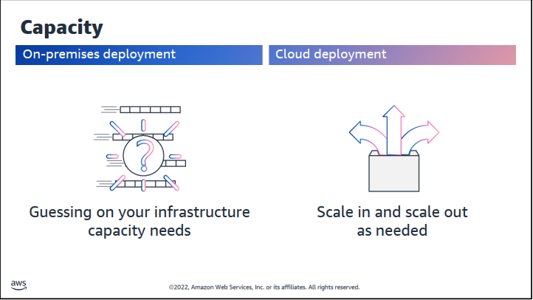

Slide 17
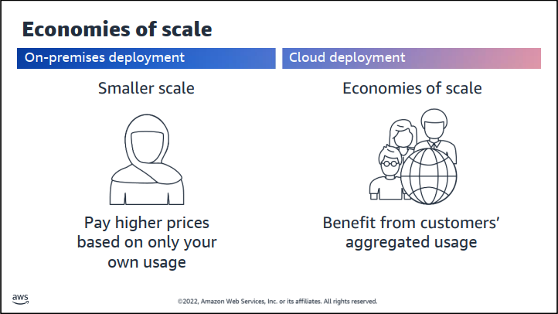

Slide 18
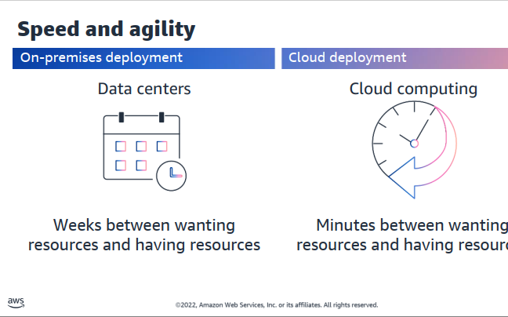

Slide 19
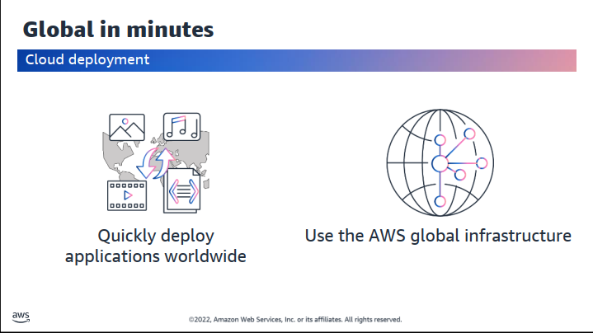

Slide 20
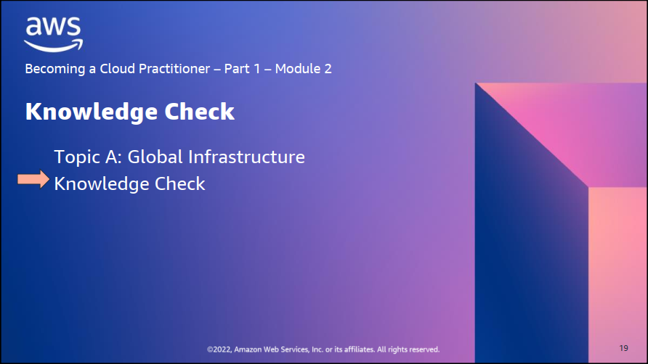

Slide 21
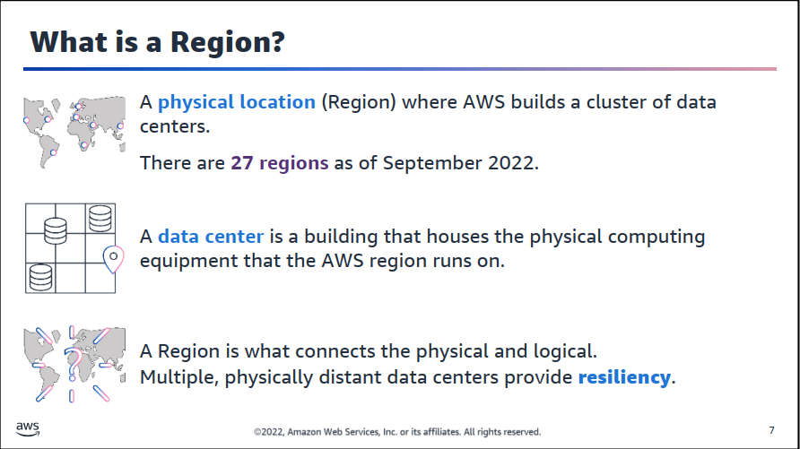

Slide 22
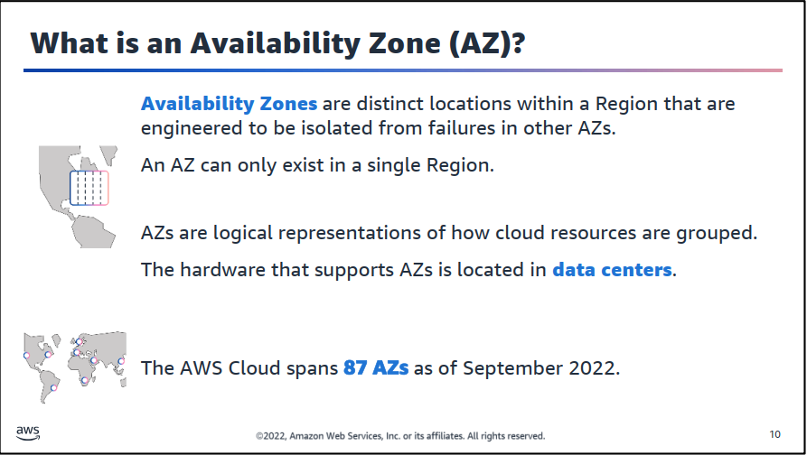

Slide 23
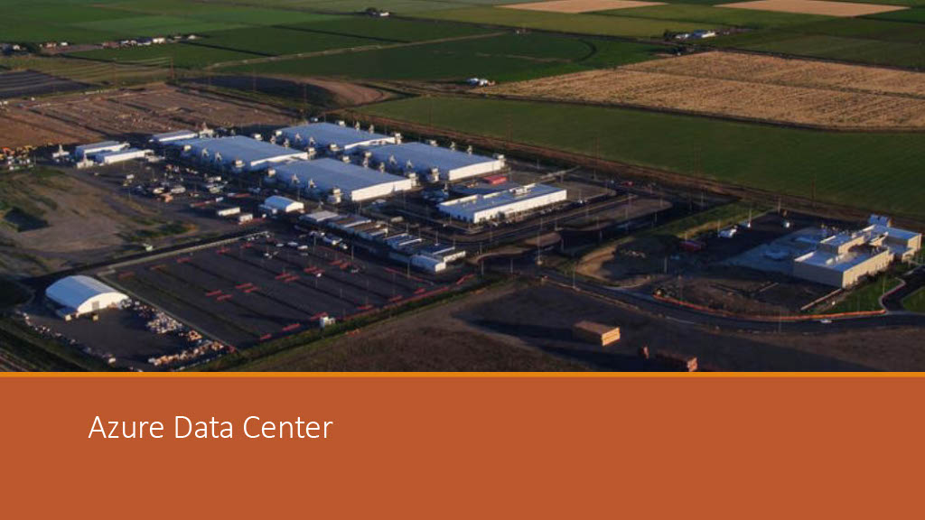

Slide 24
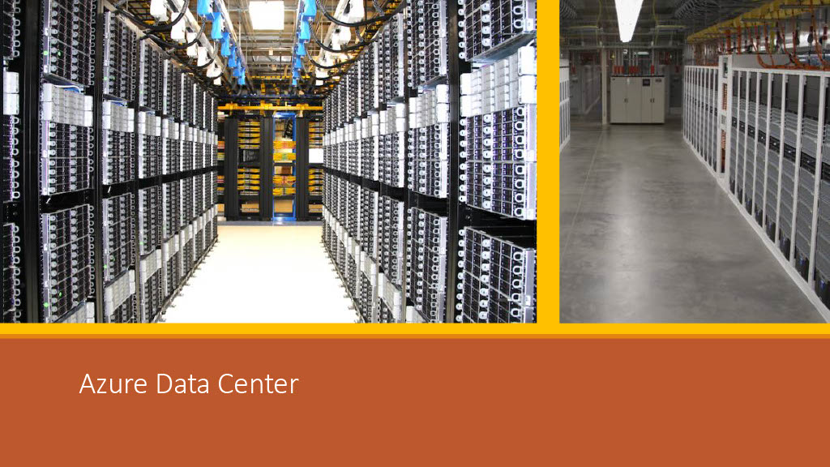

Slide 25
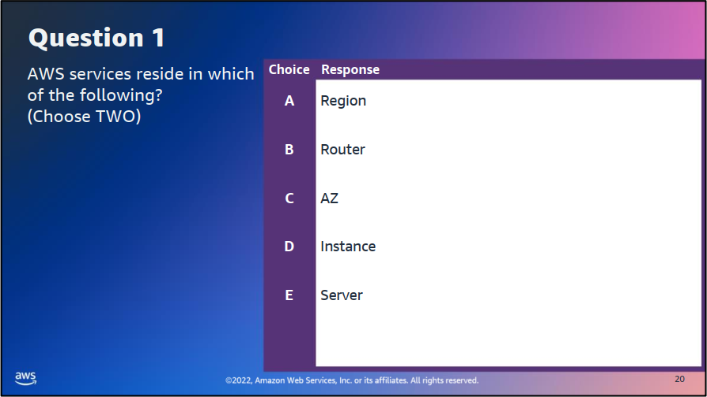

Slide 26
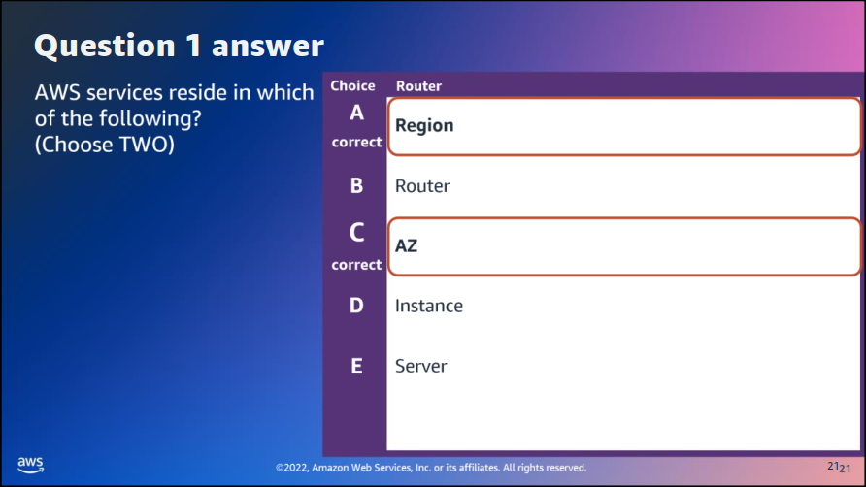

Slide 27
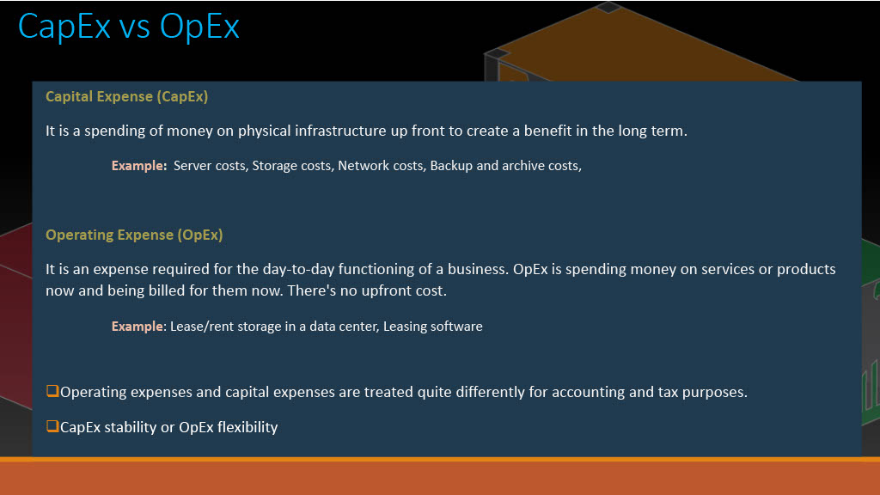

Slide 28
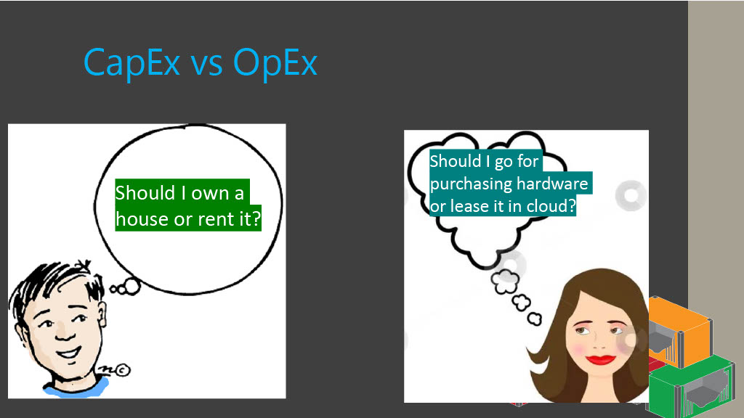

Slide 29
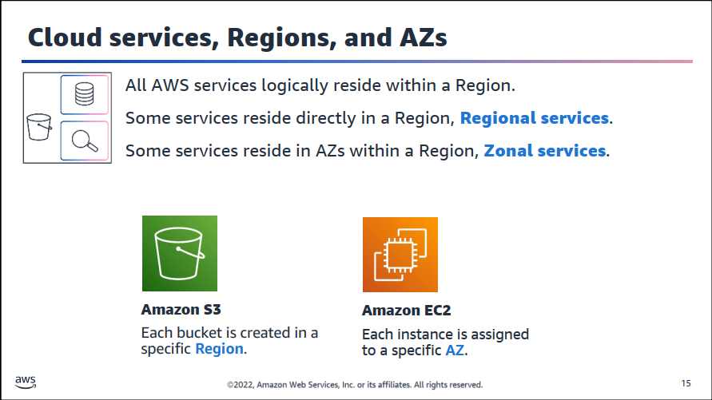

Slide 30
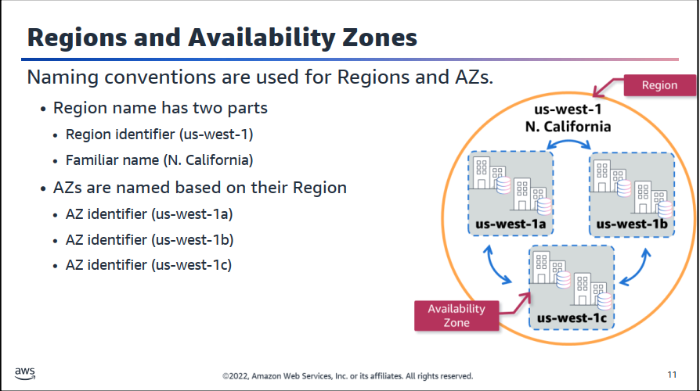

Slide 31
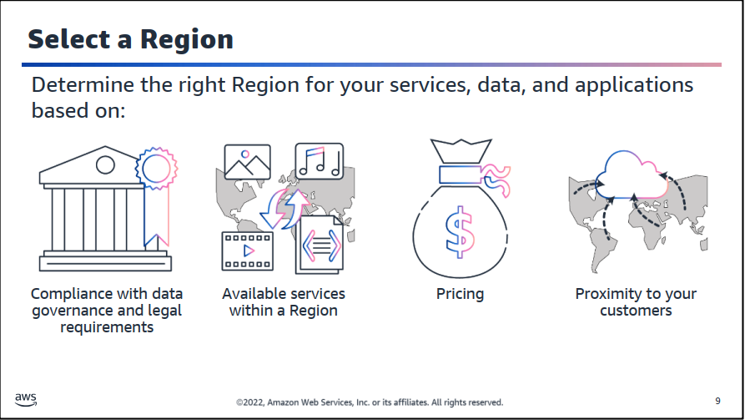

Slide 32
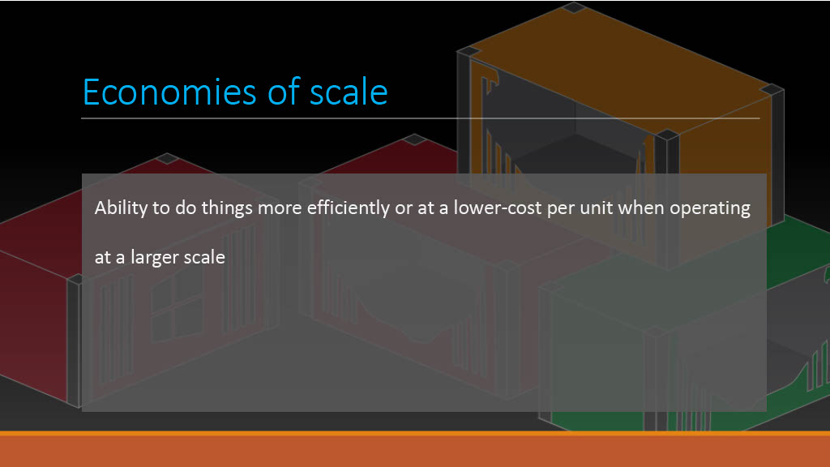

Slide 33
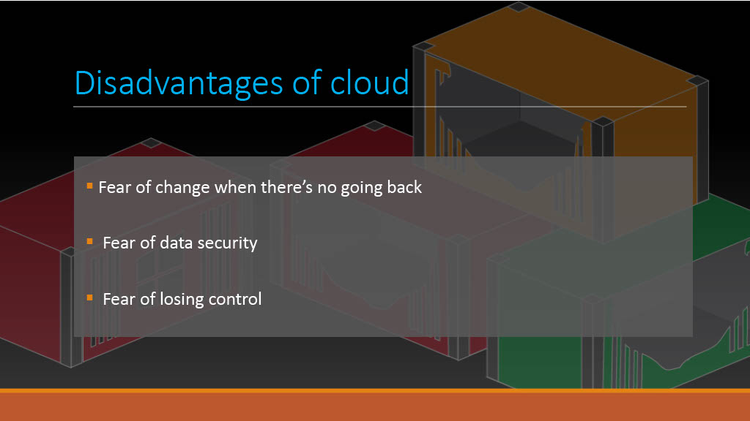

Slide 34
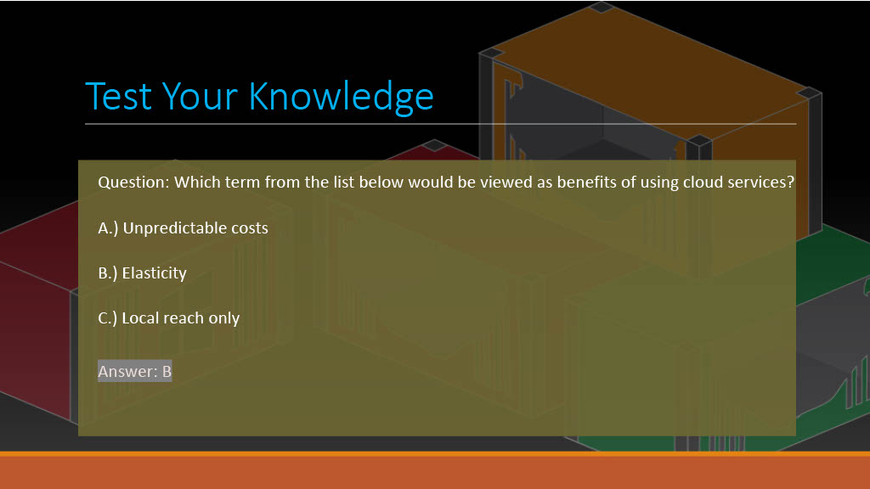

Slide 36
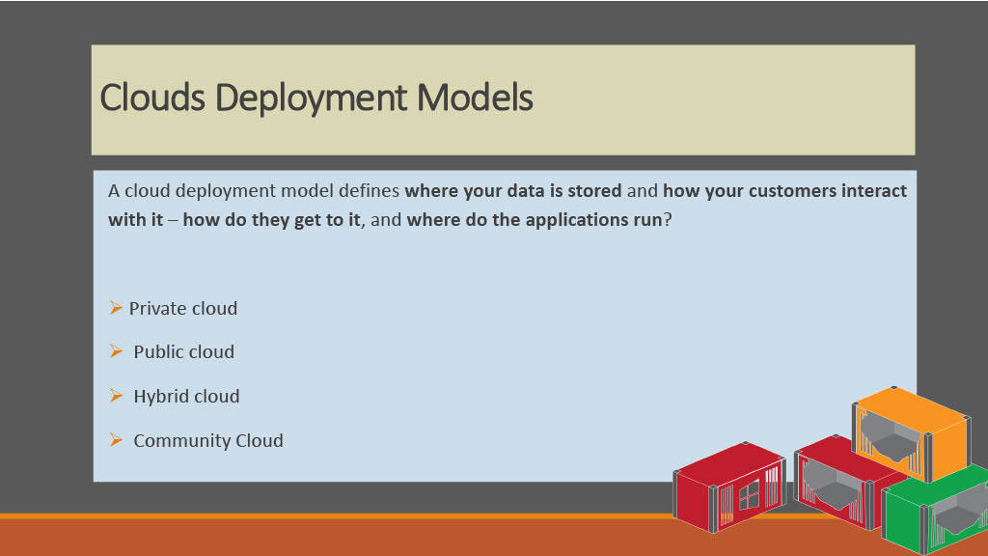

Slide 37
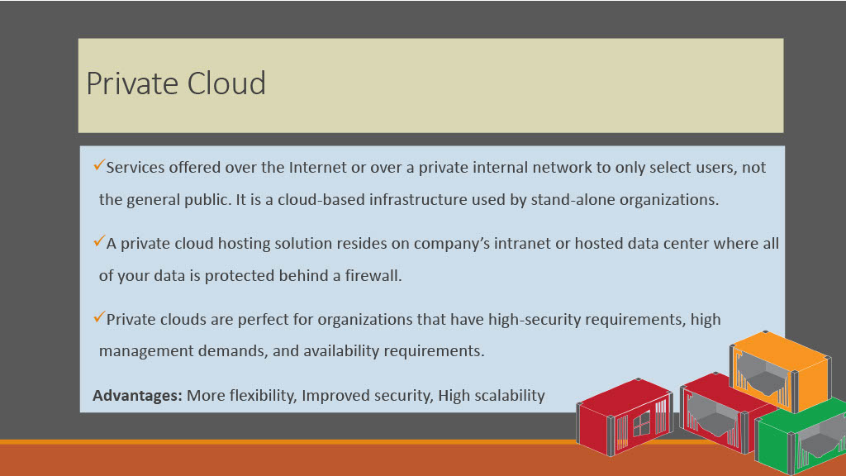

Slide 38
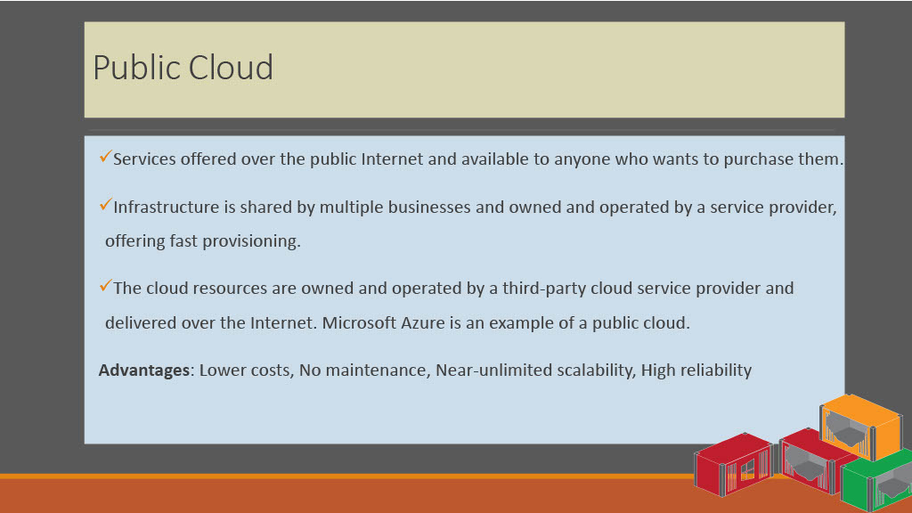

Slide 39
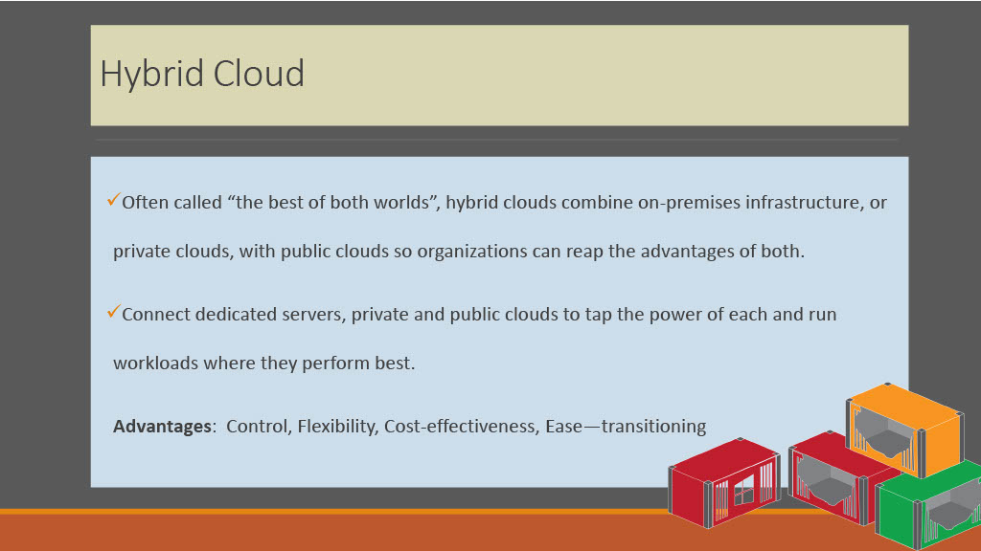
Notes:
Legacy app ---- high massive storage file server

Slide 40
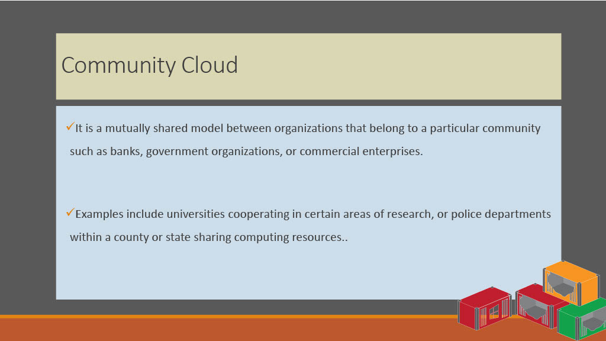

Slide 41
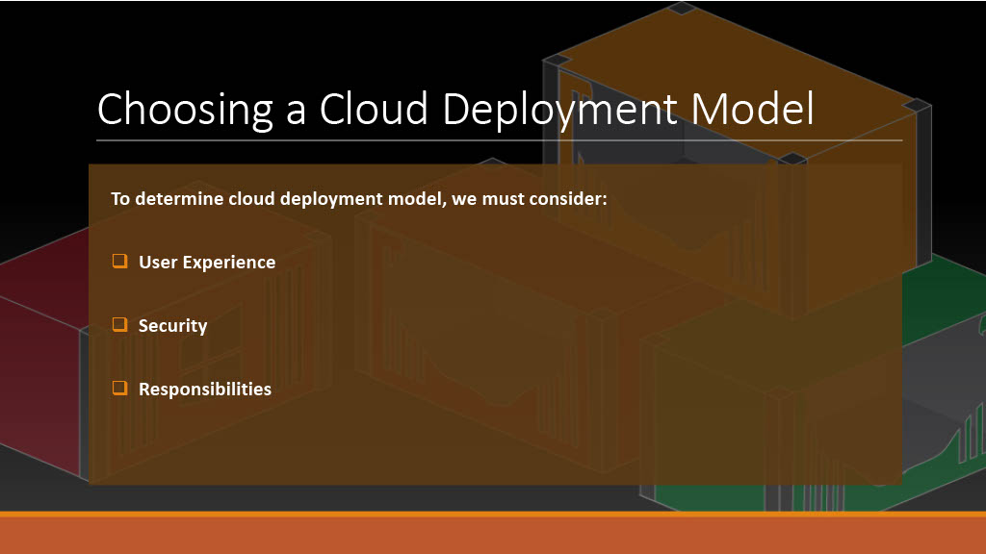

Slide 42
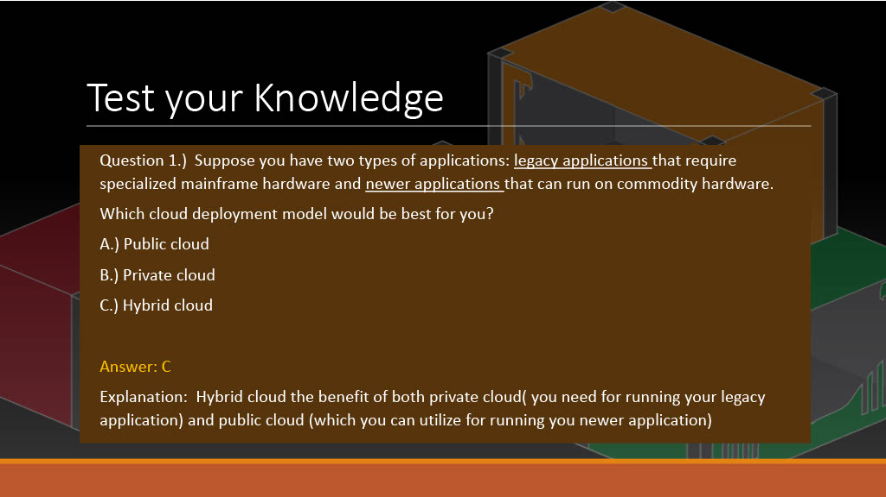

Slide 44
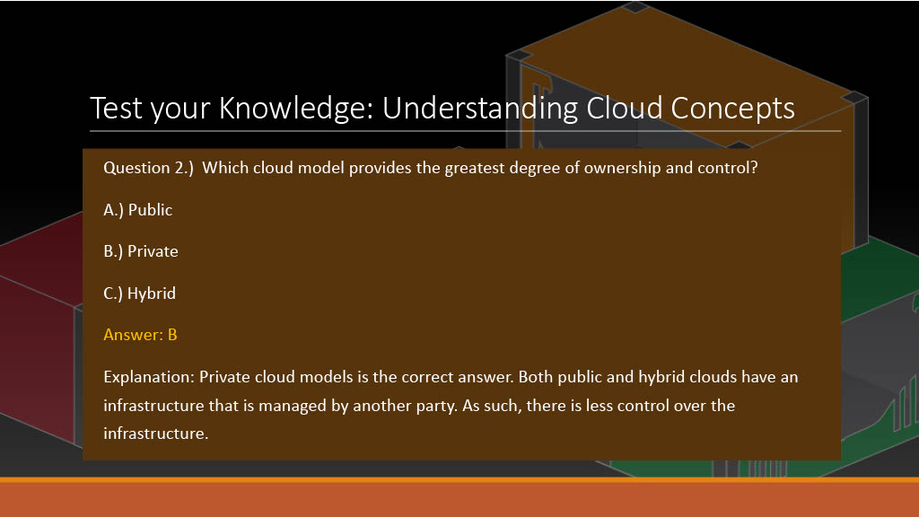

Slide 46
Cloud Computing Service Models vs Cloud Deployment Models

Slide 47
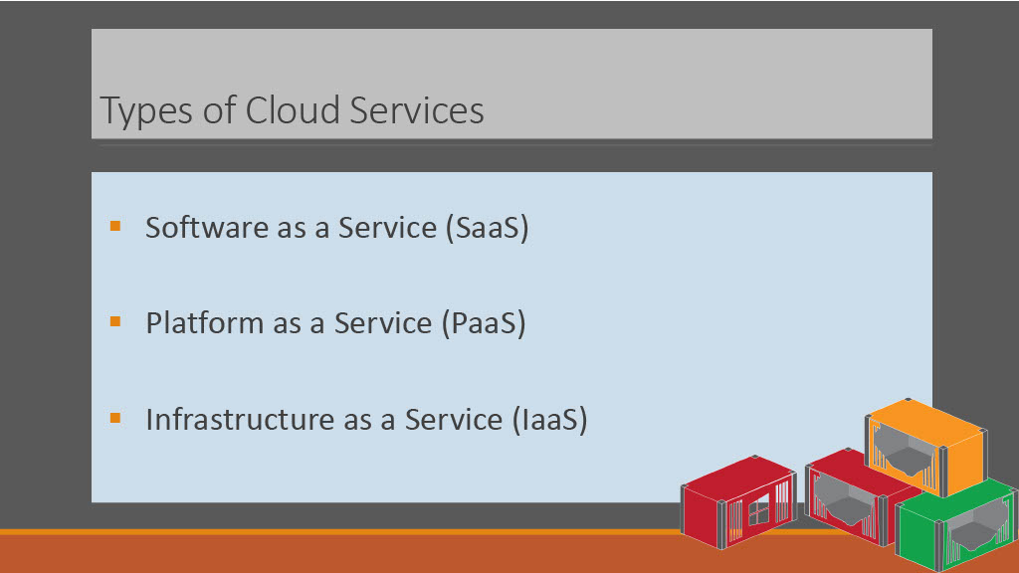
Notes:
here

Slide 48
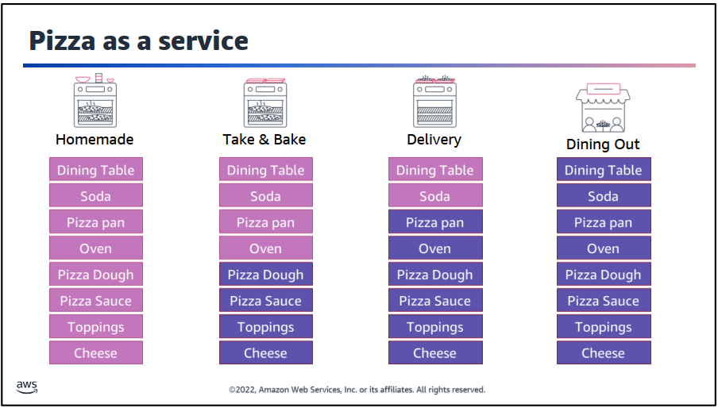
Notes:
Toppings طبقات --- --- dough عجينة – pizza pan صحنا البيتزا -- dinning table طاولة الطعام

Slide 49
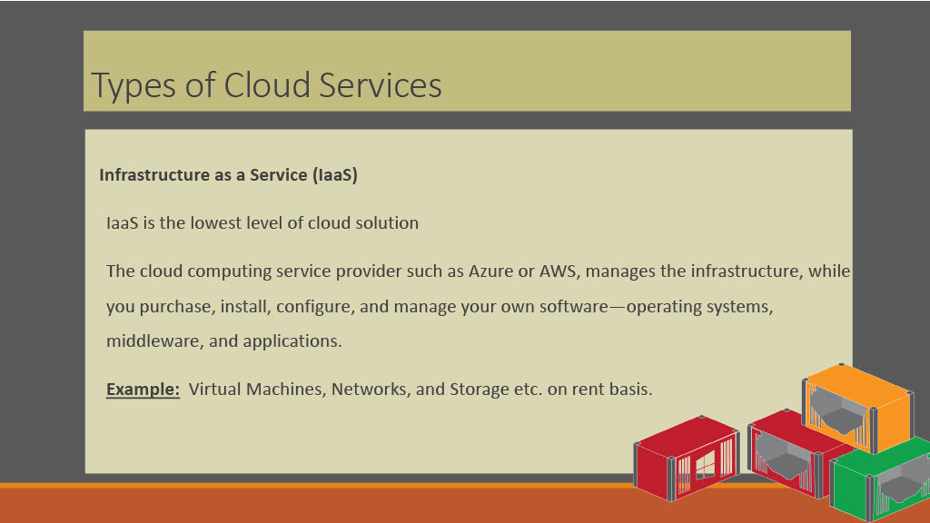
Notes:
IaaS includes networking, computing, and data storage components that you manage.

Slide 50


Slide 51
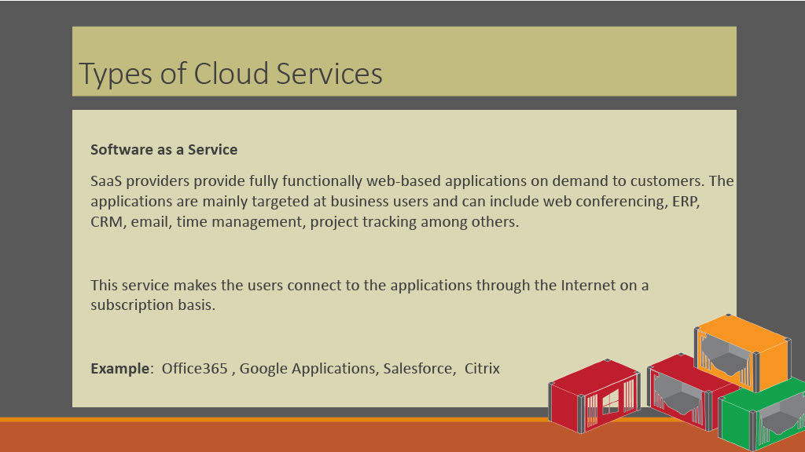
Notes:
web-based email where you can send and receive email without having to manage feature additions to the email product or maintaining the servers and operating systems that the email program is running on

Slide 52
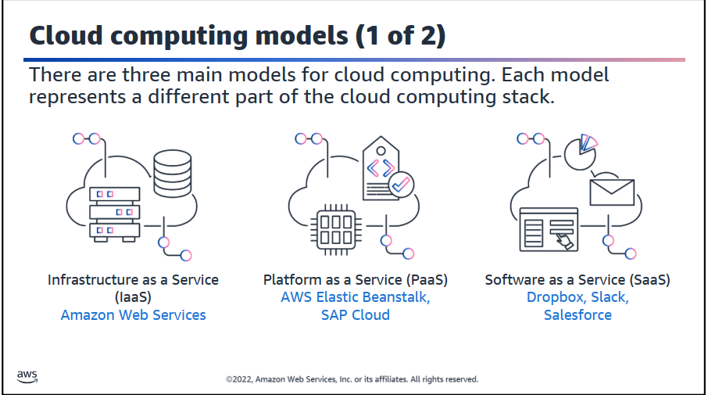

Slide 53
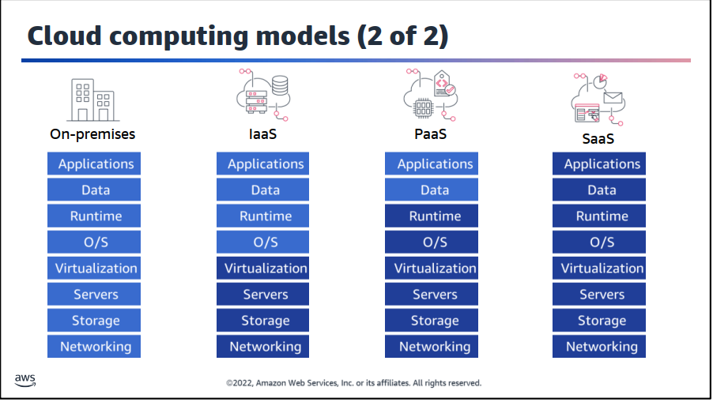

Slide 54
Computing models help us to define what responsibilities the company administrators are responsible and what a service provider will be responsible for.
In an on-premises deployment the administrator is responsible for everything.
In an IaaS deployment the administrator is responsible for the application, data, runtime, and operating system. The service provider is responsible for the virtualization, servers, storage, and networking.
In a PaaS deployment the administrator is only responsible for the application and data. The service provider is responsible for everything else.
In a SaaS deployment the administrator is no responsible for anything other that the internal application management. The service provider is responsible for everything else.

Slide 55
IaaS deployment Ex.:
Microsoft Azure IaaS, Amazon EC2, Google Compute Cloud (GCP), and Rackspace,S3,Load Balancers, Network
Flexiscale, GoGrid, Joyent, ARSyS

Slide 56
PaaS deployment Ex.:
Docker containers-as-a-service (CaaS) Amazon RDS, WebApps (WebServers), Heroku, Force.com and Google App Engine. AWS Elastic Beanstalk, Windows Azure, Heroku, Apache Stratos, OpenShift, Development tools,
SQS, Azure SQL, Aneka, Amazon Elastic MapReduce, CloudFoundry

Slide 57
SaaS deployment Ex.:
Google Apps, Microsoft Office 365, and Salesforce, Google Workspace, Dropbox, Salesforce, Cisco WebEx, SAP Concur, GoToMeeting, online
mail, project-management systems, CRMs, and social media platforms, ERP,
Symantec online backup, Zoho, Smartsheet, NetSuite

Slide 58
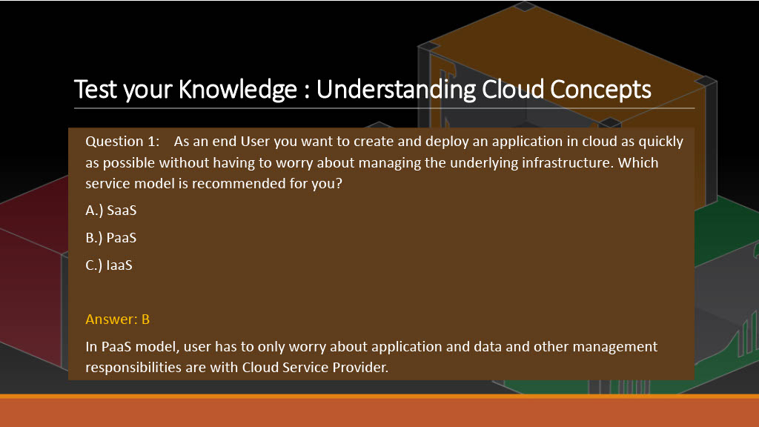

Slide 60



Slide 62
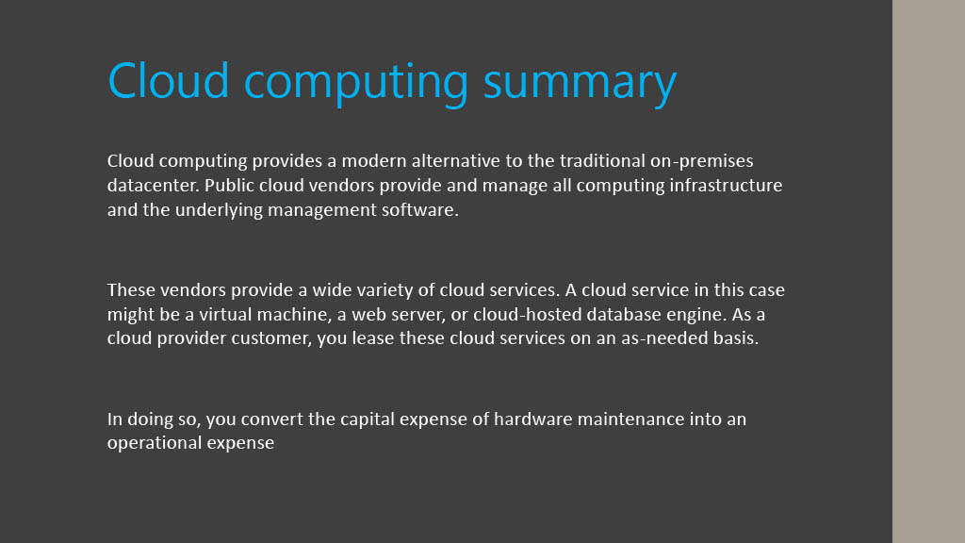

Slide 63
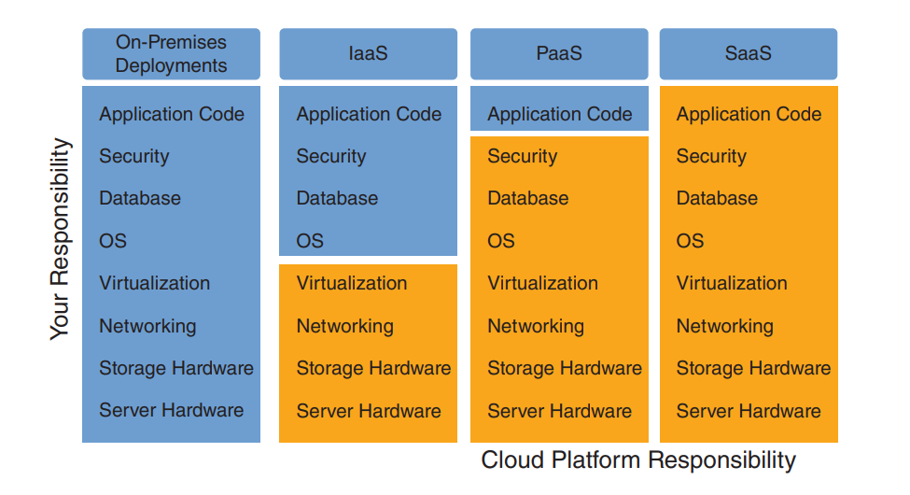

Slide 64
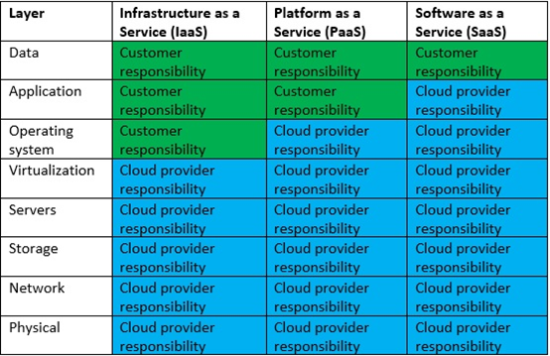

Slide 65
https://aws.amazon.com/ar/blogs/industries/applying-the-aws-shared-responsibility-model-to-your-gxp-solution/

Slide 66


Slide 67


Slide 68
Customers are responsible for the security of everything that they create and put in the AWS Cloud.

Slide 69
AWS is responsible for security of the cloud.
AWS operates, manages, and controls the components at all layers of infrastructure. This includes areas such as
the host operating system, the virtualization layer, and even the physical security of the data centers from which
services operate

Slide 70
تعد Amazon Web Services (AWS) منصة سحابية شهيرة توفر مجموعة واسعة من الخدمات السحابية للشركات والأفراد. وتشمل الخدمات التي توفرها AWS الحوسبة السحابية، وخدمات التخزين السحابي، وخدمات قواعد البيانات، وخدمات الشبكات، وخدمات الأمان السحابي، وغيرها الكثير. وتتميز AWS بالمرونة والتوفير الكبير في التكاليف والتشغيل السريع والسهل.

Slide 71
خدمات التخزين السحابي:
توفر AWS خدمات تخزين البيانات السحابية، بما في ذلك Amazon S3 و Amazon Glacier و Amazon EFS و Amazon EBS و Amazon FSx وغيرها. وتتيح هذه الخدمات تخزين البيانات بأمان وسهولة وفي مواقع متعددة، كما تتضمن خيارات النسخ الاحتياطي واستعادة البيانات.

Slide 72
خدمات قواعد البيانات:
توفر AWS خدمات قواعد البيانات السحابية، بما في ذلك Amazon RDS و Amazon DynamoDB و Amazon Redshift و Amazon Aurora وغيرها. وتتيح هذه الخدمات إدارة البيانات بسهولة وفعالية، وتوفر الأدوات اللازمة للتكوين والتحسين والمراقبة.

Slide 73
خدمات الشبكات:
توفر AWS خدمات شبكات سحابية تتضمن Amazon VPC و AWS Direct Connect و Amazon Route 53 و CloudFront، والتي تتيح إدارة الشبكات الافتراضية بسهولة وتوفر الأدوات اللازمة لتوزيع المحتوى وتحسين الأداء.

Slide 74
خدمات الأمان السحابي:
توفر AWS خدمات الأمان السحابي، بما في ذلك AWS Identity and Access Management و AWS Key Management Service و Amazon Guard Duty و AWS WAF و Amazon Inspector و CloudTrail، والتي تتيح إدارة الوصول والتحكم في البيانات والكشف عن التهديدات والتحقق من الامتثال.

Slide 75
إضافة إلى ذلك، توفر AWS خدمات أخرى مثل خدمات الذكاء الاصطناعي والحوسبة الكمية والأدوات التحليلية، والتي تتيح
للشركات والأفراد استخدام التقنيات الحديثة للتحليل والتعلم الآلي والتحسين المستمر.
يمكن القول إن AWS هي منصة سحابية شاملة وشهيرة وتوفر العديد من الخدمات السحابية المتطورة، والتي يمكن استخدامها لتلبية متطلبات الشركات والمؤسسات والأفراد في مختلف المجالات. ومن المهم الإشارة إلى أن AWS توفر العديد من الأدوات والموارد التعليمية المجانية على موقعها الرسمي، مما يجعل من السهل بدء العمل مع هذه الخدمات

Slide 76


Slide 77


Slide 79
EC2: The AWS Compute Service
Have you ever considered working from any place in the world, whether it is your home or another location? Isn’t it fascinating? It is feasible with Amazon EC2. You can work from your home or any other location while maintaining a secure and safe IT environment. You do not have to be concerned about the hardware system or manage anything.

Slide 80
AWS provides a broad range of services in areas such as compute, storage, database, migration, network, management tools, media services, security, business productivity, application integration, machine learning, game creation, and more. EC2 is included in the compute capacity category.
In this article, we will dive deeper into what the AWS EC2 service is all about.
What is EC2: The AWS Compute Service?
Amazon EC2 or Amazon Elastic Compute Cloud is a web service that seeks to make developers’ lives easier by providing secure and scalable cloud computing resources. In general terms, EC2 allows users to rent virtual computers that are known as virtual machines on which they can execute their computer applications.
Rather than purchasing and connecting your own hardware, Amazon provides you with practically unlimited virtual machines on which you can execute your apps while they handle the hardware.
It is effortless to scale up and down our infrastructure based on demand using EC2. This service can be linked easily with practically all of Amazon’s services, and the most significant part may be that we only pay for what we use .

Slide 81
Benefits of EC2:
Below are a few of the advantages of using EC2:
AWS EC2 does not require any hardware components, hardware management, or physical hardware provisioning.
It is quite simple to scale up and down our infrastructure in response to demand.
The EC2 service works well with practically all of Amazon’s services.
We do not have to commit upfront, and we only pay for what we have used.
It can be accessed from any location in the world like any other cloud service.
Users can have complete control from their end.
It provides a wide range of operating systems to choose from.
It speeds up the deployment of new servers.

Slide 82
Features of Amazon EC2:
Functionality – EC2 provides its users a true virtual computing platform, where they can use various operations and even launch another EC2 instance from this virtually created environment. This will increase the security of the virtual devices. Not only creating but also EC2 allows us to customize our environment as per our requirements, at any point of time during the life span of the virtual machine.

Slide 83
Features of Amazon EC2:
Amazon EC2 itself comes with a set of default AMI(Amazon Machine Image) options supporting various operating systems along with some pre-configured resources like RAM, ROM, storage, etc. Besides these AMI options, we can also create an AMI curated

Slide 84
Features of Amazon EC2:
Operating Systems – Amazon EC2 includes a wide range of operating systems to choose from while selecting your AMI. Not only these selected options, but users are also even given the privileges to upload their own operating systems and opt for that while selecting AMI during launching an EC2 instance. Currently, AWS has the following most preferred set of operating systems available on the EC2 console.

Slide 85


Slide 86
Features of Amazon EC2:
Software AWS Marketplace

Slide 87
Components of EC2: The AWS Compute Service
Virtual Private Clouds (VPCs): They are virtual networks that you can create that are conceptually isolated from the other part of the AWS cloud and can optionally connect to your own network.
Instances: They are virtual computing environments.
Amazon Machine Images (AMIs): They are the set of pre-configured templates for your instances that bundle the components you will need for your server.
Amazon EBS volumes: They are Amazon Elastic Block Store-based persistent storage volumes for your data.
Instance types: They are the numerous CPU, memory, storage, and networking configurations for your instances.

Slide 88


Slide 89
S3
AWS Simple Storage Service (S3): From the aforementioned list, S3, is the object storage service provided by AWS. It is probably the most commonly used, go-to storage service for AWS users given the features like extremely high availability, security, and simple connection to other AWS Services. AWS S3 can be used by people with all kinds of use cases like mobile/web applications, big data, machine learning and many more.

Slide 90
S3
AWS S3 Terminology:
Bucket: Data, in S3, is stored in containers called buckets.
Each bucket will have its own set of policies and configuration. This enables users to have more control over their data.

Slide 91
S3
Bucket Names must be unique.
Can be thought of as a parent folder of data.
There is a limit of 100 buckets per AWS accounts. But it can be increased if requested from AWS support.

Slide 92
S3
Bucket Owner: The person or organization that owns a particular bucket is its bucket owner.

Slide 93
S3
Versioning: Versioning means to always keep a record of previously uploaded files in S3. Points to note:
Versioning is not enabled by default. Once enabled, it is enabled for all objects in a bucket.

Slide 94
S3
Versioning keeps all the copies of your file, so, it adds cost for storing multiple copies of your data. For example, 10 copies of a file of size 1GB will have you charged for using 10GBs for S3 space.

Slide 95
S3
Versioning is helpful to prevent unintended overwrites and deletions.
Note that objects with the same key can be stored in a bucket if versioning is enabled (since they have a unique version ID).

Slide 96
S3
Object: Fundamental entity type stored in AWS S3.

Slide 97
S3
Access Control Lists (ACL): A document for verifying the access to S3 buckets from outside your AWS account. Each bucket has its own ACL.

Slide 98
S3
Bucket Policies: A document for verifying the access to S3 buckets from within your AWS account, this controls which services and users have what kind of access to your S3 bucket. Each bucket has its own Bucket Policies.

Slide 99
S3
Features of AWS S3:
Durability: AWS claims Amazon S3 to have a 99.999999999% of durability (11 9’s). This means the possibility of losing your data stored on S3 is one in a billion.

Slide 100
S3
Availability: AWS ensures that the up-time of AWS S3 is 99.99% for standard access.
Note that availability is related to being able to access data and durability is related to losing data altogether.

Slide 101
S3
File Size support: AWS S3 can hold files of size ranging from 0 bytes to 5 terabytes. A 5TB limit on file size should not be a blocker for most of the applications in the world.

Slide 102
S3
Infinite storage space: Theoretically AWS S3 is supposed to have infinite storage space. This makes S3 infinitely scalable for all kinds of use cases.

Slide 103
S3
Pay as you use: The users are charged according to the S3 storage they hold.

Slide 104
S3
AWS-S3 is region-specific.

Slide 105
S3
S3 Glacier:
S3 Glacier is a durable, secure, and extremely low-cost S3 storage class for data archiving and long-term backup. S3 glacier provides the facility of storing the archived data and you don’t need to think about the administrative burden such as capacity planning, health checks of drives, recovery planning, etc.

Slide 107
S3
Benefits:
In five simple and easy steps you have learned how to host your static website out of AWS S3. Not to mention you scored some benefits from moving your static website to S3.

Slide 108
S3
Benefits:
Low cost — Hosting a website in S3 does not incur extra charges. You are paying standard S3 prices on GET requests and Data Transfer out of the bucket when a user visits your site.

Slide 109
S3
Benefits:
Low cost — Hosting a website in S3 does not incur extra charges. You are paying standard S3 prices on GET requests and Data Transfer out of the bucket when a user visits your site.
GET Requests cost $0.004 per 10,000 requests
Data Transfer Out cost $0.090 per GB (up to 10 TB / month)

Slide 110
S3
Benefits:
A Cost breakdown example: Let’s say that www.my-awesome-site.com loads 20 resources. The total size of those resources per visit is 1MB. The average total monthly visits is 20,000. Then we estimate the total cost of S3 on a monthly basis at around $1.96 per month.
Not long ago, you paid $10/month, so $2 is worth it.

Slide 111
S3
Benefits:
Maintenance — Your static website now resides in S3. There is no longer any server side code to maintain and no web servers to configure and keep up to date.

Slide 112
S3
Benefits:
Scale — S3 is a high availability and durable service that AWS maintains. If your website goes from 10 users a day to 10 million, S3 scales your website automatically.

Slide 113
S3
Benefits:
Security — There is no server running that you maintain. Thus you avoid making configuration errors that make you vulnerable to attacks. You are still responsible for the security of your bucket.

Slide 115
IAM
Identity and Access Management (IAM)
is a combination of policies and technologies that allows organizations to identify users and provide the right form of access as and when required

Slide 116
IAM
Components of IAM
Users
Roles
Groups
Policies

Slide 117
IAM
Components of IAM
Users
Roles
Groups
Policies

